Slide 1
ARL RFE APEX APPLICATION
By Derek Truong and Charlotte Sheng

Slide 2
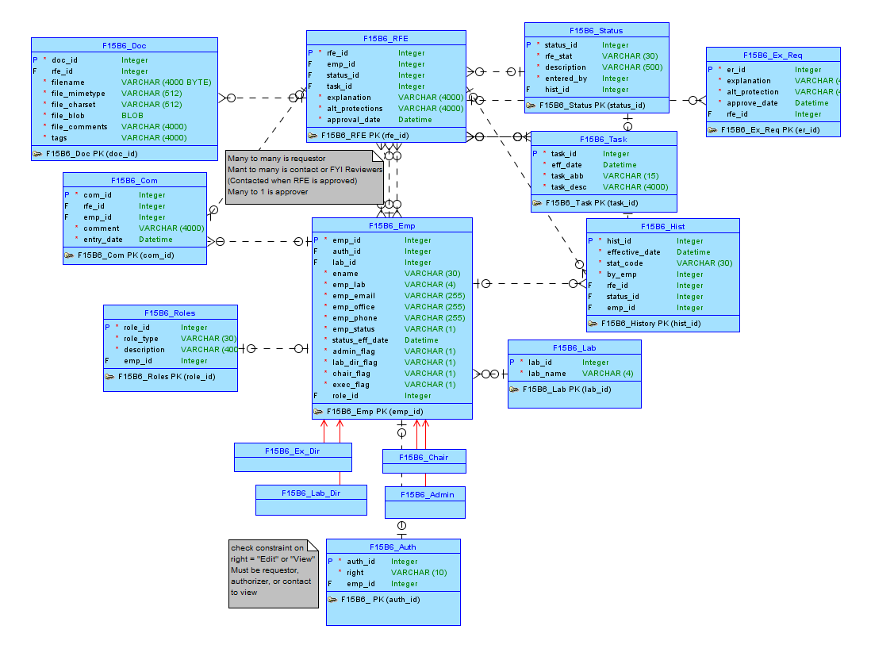
Conceptual Model

Slide 3
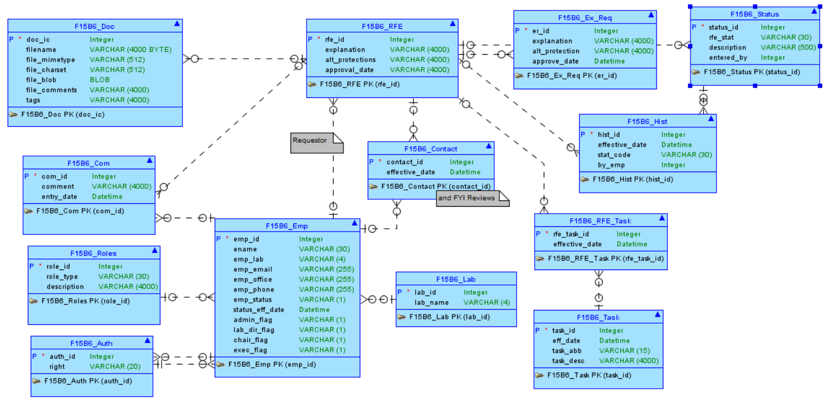
Logical Model

Slide 4
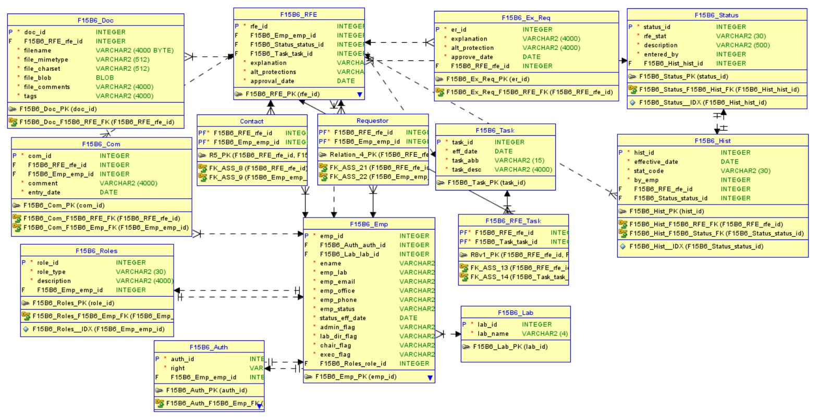
Relational Model

